Slide 1


고객가치
새로운 시도
집요한 실행
ToF measurement Errors

Slide 2
Classification of the errors
ToF Camera
Errors in the depth measurement using the ToF cameras
Errors
Systematic
Depth Distortion
Wiggling, Circular Error
Depends only on the measured depth for each pixel.
Caused by imaging conditions.
Generally managed by calibration.
Integration-time-related error
Different IT gives different depth values.
Main reason is still under investigation.
Built-in pixel-related errors
Due to different material properties in CMOS-gates
Due to capacitor charge time delay.
Amplitude related errors
Gaussian beam shape.
Low illumination for each object.
Difference in object reflectance.
Temperature-related errors
Non-systematic
Temperature affects the data processing.
Just wait until the temperature reaches an adequate level.
Caused by external environments and noise.
Generally managed by filtering.
Machine Learning is also taken.
References
Foix, S., Alenyà, G., & Torras, C. (2011). Lock-in ToF Cameras - A Survey. Ieee Sensors Journal, 11(9), 1917–1926.
He, Y., Liang, B., Zou, Y., He, J., & Yang, J. (2017). Depth errors analysis and correction for time-of-flight (ToF) cameras. Sensors (Switzerland), 17(1). https://doi.org/10.3390/s17010092

Slide 3
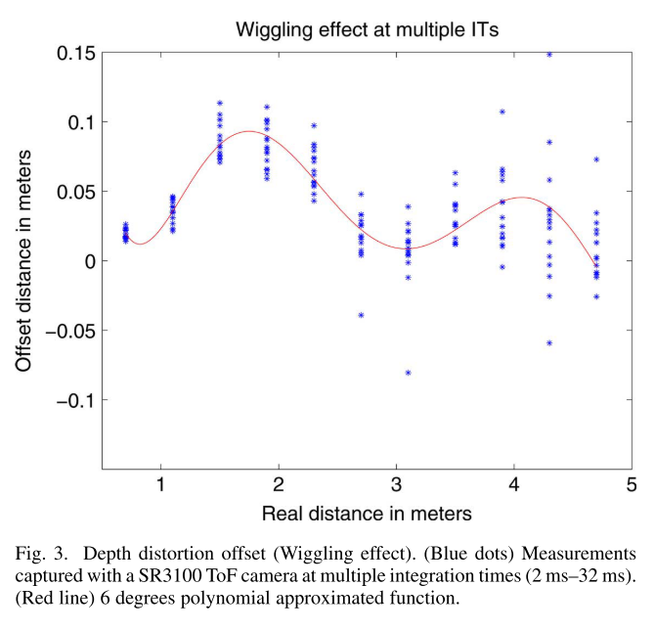
Systematic errors: Depth Distortion
ToF Camera
Caused because the emitted laser cannot be generated in practice as theoretically planned.
Produces an offset that depends only on the measured depth.
Usually, it shows a sinusoidal shape.
Correction 1: Compare to reference ground truth distance. Needs an additional sensor to acquire reference data.
Correction 2: Optimizing the errors by modeling the errors. Only applicable in a limited range. Examples of modeling: Look-up table, B-Spline, Polynomial regression.
References
Foix, S., Alenyà, G., & Torras, C. (2011). Lock-in ToF Cameras - A Survey. Ieee Sensors Journal, 11(9), 1917–1926.
He, Y., Liang, B., Zou, Y., He, J., & Yang, J. (2017). Depth errors analysis and correction for time-of-flight (ToF) cameras. Sensors (Switzerland), 17(1). https://doi.org/10.3390/s17010092

Slide 4
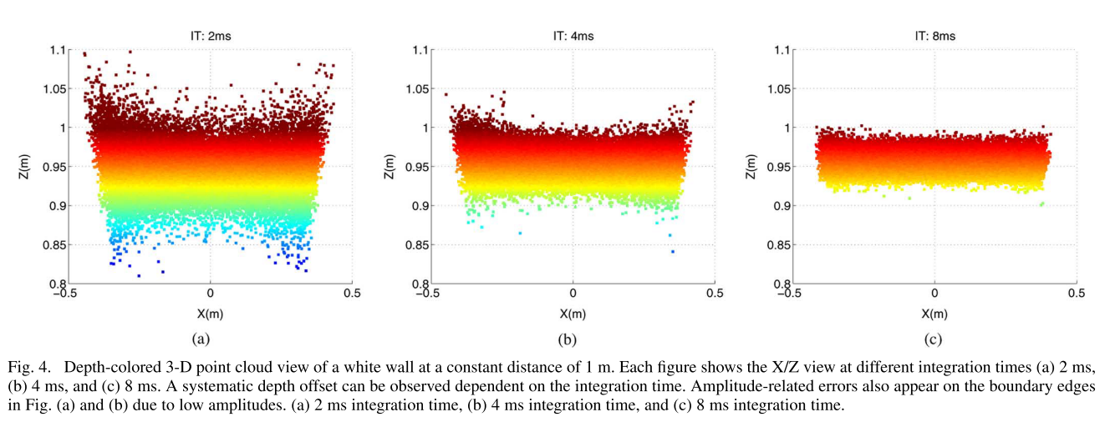
Systematic errors: Integration-time-related error
ToF Camera
For the same scene different IT gives different depth values.
The main reason is still a subject of investigation.
Modulating the IT affects other Calibration methods. So, the auto mode for IT is not recommended.
Correction 1: Choose one IT, perform the other calibrations and never change it. For short-range detection.
Correction 2: Repeat depth distortion calibration for different IT. Then apply it according to the current IT.
References
Foix, S., Alenyà, G., & Torras, C. (2011). Lock-in ToF Cameras - A Survey. Ieee Sensors Journal, 11(9), 1917–1926.
He, Y., Liang, B., Zou, Y., He, J., & Yang, J. (2017). Depth errors analysis and correction for time-of-flight (ToF) cameras. Sensors (Switzerland), 17(1). https://doi.org/10.3390/s17010092

Slide 5
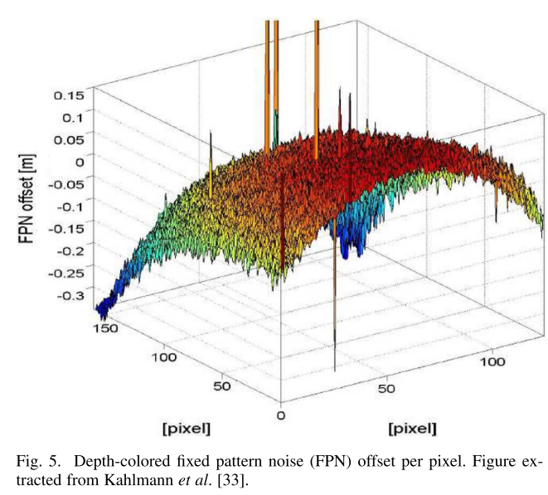
Systematic errors: Built-in pixel-related error
ToF Camera
Reason 1: Different material properties in CMOS gates.
Reason 2: Capacitor charge time delay during the signal correlation process.
Commonly represented with a fixed pattern noise (FPN) table. Comparison to computed depth with a reference depth.
Always coupled with the amplitude-related errors.
References
Foix, S., Alenyà, G., & Torras, C. (2011). Lock-in ToF Cameras - A Survey. Ieee Sensors Journal, 11(9), 1917–1926.
He, Y., Liang, B., Zou, Y., He, J., & Yang, J. (2017). Depth errors analysis and correction for time-of-flight (ToF) cameras. Sensors (Switzerland), 17(1). https://doi.org/10.3390/s17010092

Slide 6
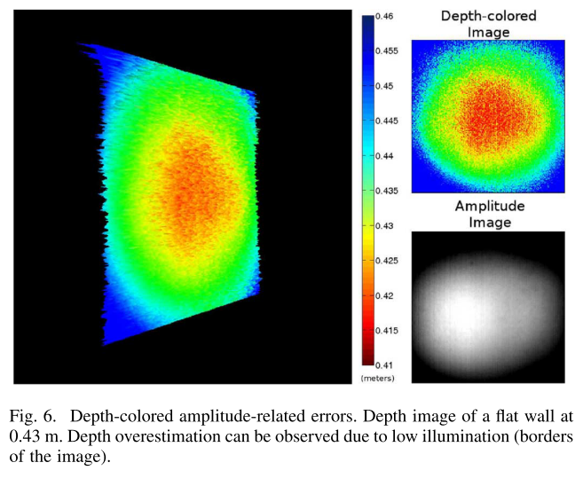
Systematic errors: Amplitude-related errors
ToF Camera
Due to low or overexposed reflected amplitudes.
The low amplitude at the border → Overestimating depth at the edges.
Overexposed by Too-close-to-the camera or too-long-IT → Overestimating the center.
Reason 1: Gaussian beam shape.
Reason 2: Low illumination for each object.
Reason 3: Difference in object reflectance. (Different depth measurements for pixels at the same distances.)
Correction 1: Filter pixels with amplitudes lower than a threshold. → Possibility of losing too many portions of the images.
Correction 2: Extending the IT.
Correction 3: Take the median of built-in pixel-related and amplitude-related errors for various reflectance and use them as a look-up table.
References
Foix, S., Alenyà, G., & Torras, C. (2011). Lock-in ToF Cameras - A Survey. Ieee Sensors Journal, 11(9), 1917–1926.
He, Y., Liang, B., Zou, Y., He, J., & Yang, J. (2017). Depth errors analysis and correction for time-of-flight (ToF) cameras. Sensors (Switzerland), 17(1). https://doi.org/10.3390/s17010092

Slide 7
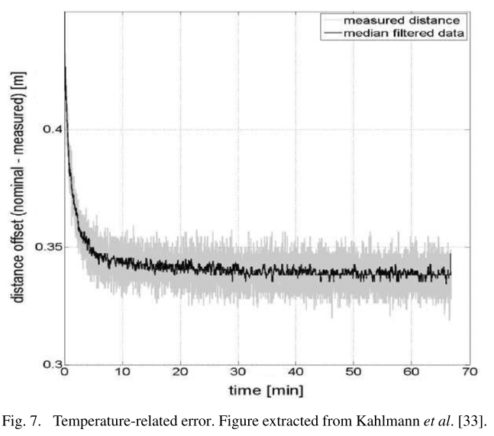
Systematic errors: Temperature-related errors
ToF Camera
Reason: Happens because internal camera temperature affects depth processing.
Correction: Switch on the camera and wait until the temperature of the camera becomes stable.
Overestimation has been observed in the SR-2 SwissRanger camera.
References
Foix, S., Alenyà, G., & Torras, C. (2011). Lock-in ToF Cameras - A Survey. Ieee Sensors Journal, 11(9), 1917–1926.
He, Y., Liang, B., Zou, Y., He, J., & Yang, J. (2017). Depth errors analysis and correction for time-of-flight (ToF) cameras. Sensors (Switzerland), 17(1). https://doi.org/10.3390/s17010092

Slide 8
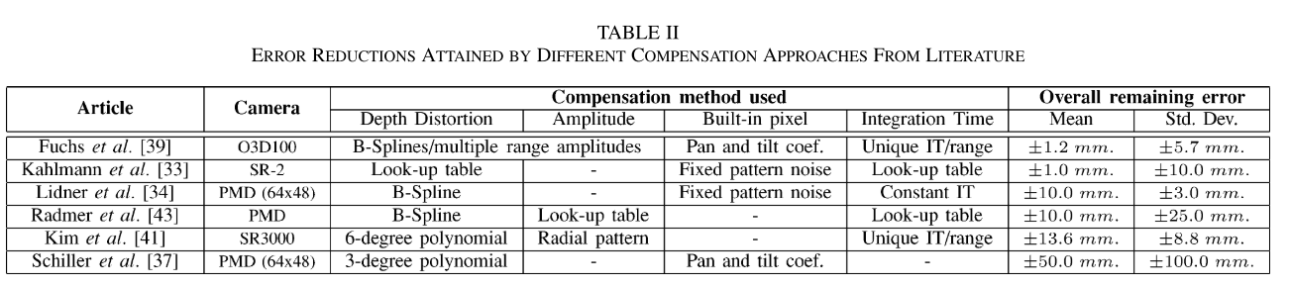
Error reductions found in literatures
ToF Camera
Comparison between the Compensation method used in literature.
The first two results were able to obtain errors of less than 3mm, by reducing three main error sources:
depth distortion (40%)
integration-time-related errors. (33.3%)
built-in pixel-related errors (6.6%)
For some of the systematic errors, the attribution for error reduction was quantified by Rapp.
References
Foix, S., Alenyà, G., & Torras, C. (2011). Lock-in ToF Cameras - A Survey. Ieee Sensors Journal, 11(9), 1917–1926.
He, Y., Liang, B., Zou, Y., He, J., & Yang, J. (2017). Depth errors analysis and correction for time-of-flight (ToF) cameras. Sensors (Switzerland), 17(1). https://doi.org/10.3390/s17010092
Rapp, Holger. "Experimental and theoretical investigation of correlating TOF-camera systems." (2007).

Slide 9
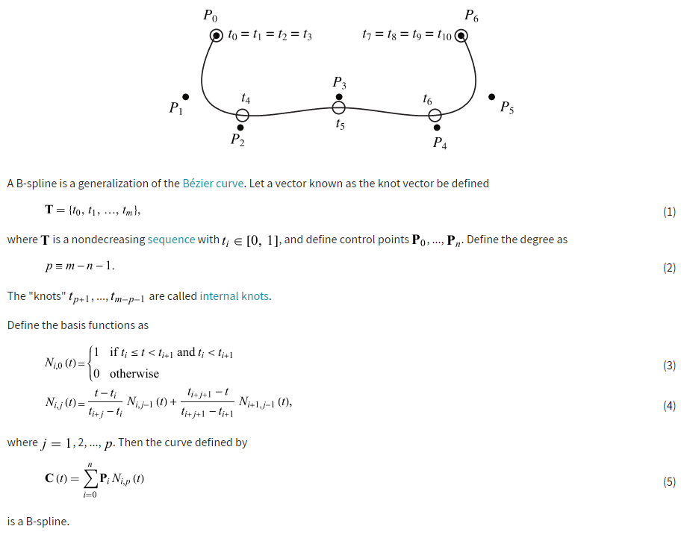
B-spline method
ToF camera

